Slide 1

Mike
Marks
Indian River
Consulting Group
Managing Organizational Change
Digital Transformation for Today’s Distributors
Fall Seminar Series

Slide 2

Managing Organization Change
“No one likes change with one exception, a wet baby”
You have an organization staffed with people that are in flow with their roles as they have figured out how to do them
Your change program is going to force all of them out of their comfort zone and ask them to live with uncertainty
This seminar is about managing the organizational changes associated with a digital transition including the sales transformation piece

Slide 3

Distribution is undergoing a major shift that was accelerated by the pandemic.
Many distributors are years into their change process, but there is no herd to follow or formula to copy
To win, a distributor must adopt an innovation mindset so they can be a fast follower

Slide 4
“50 years from now our entire life will simply be one chapter in a high school history book.
What do you think the title of the chapter will be?
I think it will be called, “ The Digitalization of Society”
– Mike Marks
What kind of change process are we talking about?
Owner-operator distributors have succeeded in the past by being frugal with expenses and reacting very quickly to opportunities and threats
Executive leadership needs to have ‘skin in the game’ on defining a desired future state that leverages where their target customers will be in several years recognizing that even they don’t really know.
The critical constraint for most distributors is that the old school sales model must change along with everyone else, or nothing will work

Slide 5
What role does the sales team play in creating change?
“The executive team must make a data driven business case around why a change is necessary”
– Mike Marks
The sales team is engaged in transaction activities influenced by negotiation. They will rarely see or recognize the changes in their own customers as every loss is interpreted as a loss based on price quoted.
Your sales team can draw out insights that create alignment around the evolving challenges facing your customers that will force them to change how they source new customers.
“The entire sales team must be involved determining what and how to change because they have a shared vision on why they need to change”

Slide 6
Understanding Your Own Organization Change Equation
You have spent time getting the team to buy into the need for change and commit to a developed future vision (F)
    The gap between F and N creates energy and excitement for change
Plan clarity deals with everyone knowing that they can do what is required for the change, measured from 0% (trust me) to 100%, it is just work
  How much of the F-N energy gap can be realized
If the net energy for change (F-N)*P exceeds the resistance to change (R) the organization will start to shift and change
C ∫ (F-N)*P > R
C = Change
F = Future State
N = Now (the current state)
P = Plan clarity (0-100%)
R = Resistance to change
The #1 priority is creating plan clarity

Slide 7
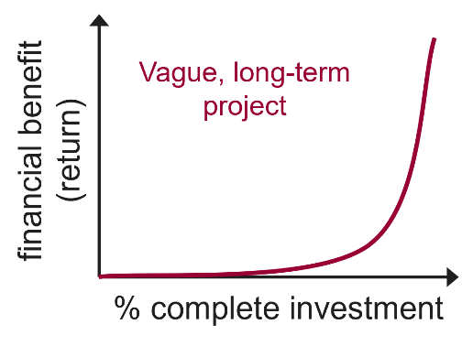
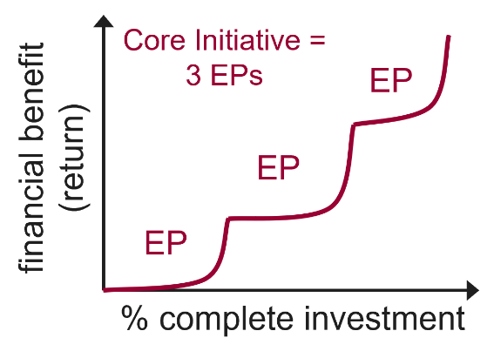
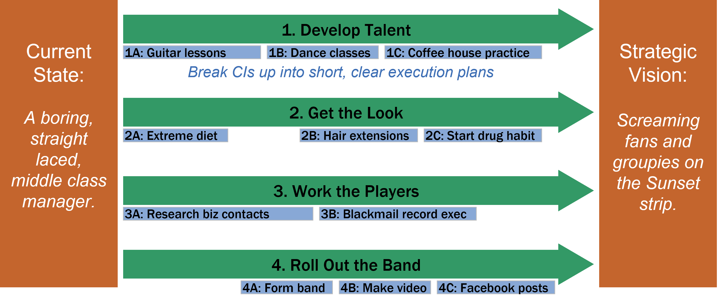
Mapping Out Your Transformation Journey – Plan Clarity
This Takes Time and Lots of Discussion Involving Many Stakeholders
High Risk Each EP helps fund the next one
The four dark green bars are Core Initiatives (CIs) that describe a long term workstream made up of multiple execution plans
This is not about selling service with excellent people. It is a description of how customers and suppliers see you that is factual and often not flattering.
Any internal bits are from the perspective of an outside investor board member viewing a real SWOT
The end state strategic vision describes a value proposition for your customers based on what you think they will need in several years, not today. It is so strong that you become their obvious first and best choice. Once defined you backward chain to create the capabilities that will be needed
An Execution Plan (EPs), the blue bars, can be completed in less than six months with a project plan and specific assignments including due dates

Slide 8
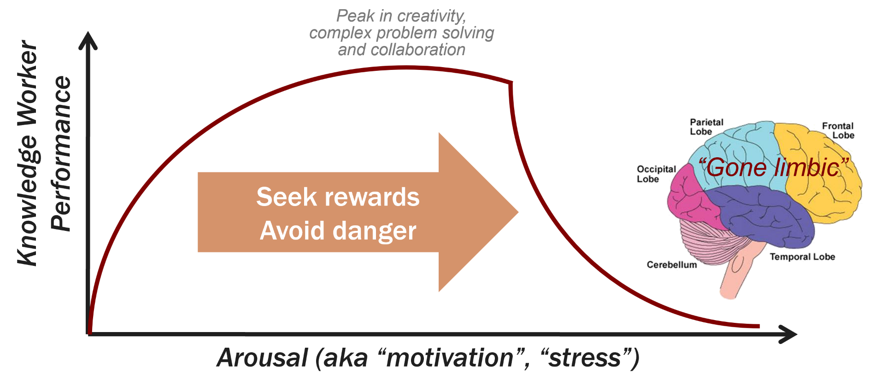
The Logic of Emotion
Stress Is Required for Change and Getting the Amount Right Is Critical
Everything depends on
people
People will only do
what they want to do
A leader’s job is to get
people to want to do
what is in the
organization’s best interests
This requires an accurate
understanding of the
emotions behind personal
motivation (i.e., psychology)
The limbic system (emotion) has biological priority over the pre-frontal cortex (logic)
Social rewards and dangers can be as powerful as physical ones
Notes:
Not managing spreadsheets or boy scouts – highly skilled, highly independent professionals (maybe even a bit whiney, needy, demanding, prima donas)
Old days couch therapy, now electrodes on skulls: neurology and evolutionary psychology
Most powerful management tool available

Slide 9
Rewards and Threats
Your Inner Coach
 | Physical
Reward | More food, water, shelter, money, sex
Danger | Risks to health and survival
Social
Higher SCARF
Lower SCARF
Managing knowledge workers requires new tools
“If then” rewards often backfire
Status: getting higher in the human pecking order
  2. Being appreciated and respected
Certainty: knowing what the future holds
  1. Quick wins, instant gratification
Autonomy: being in control of one’s own destiny
  3. Light touch management with decision making authority
Relatedness: friends are good, foes are bad
  5. Being on a winning team that has fun
Fairness: enforcing the social rules
  4. Consistent and objective rules and performance standards
Social factors are as important as physical factors
Logic is useless in many situations
Notes:
12:45
1 – quick wins like orders, games, buddy calls
2 – money is a sign of status, “good job”
3 – “if you don’t hit your numbers we may need to go to weekly reviews”
What do you do with a grizzled sales rep who won’t prospect? 2 very different answers

Slide 10
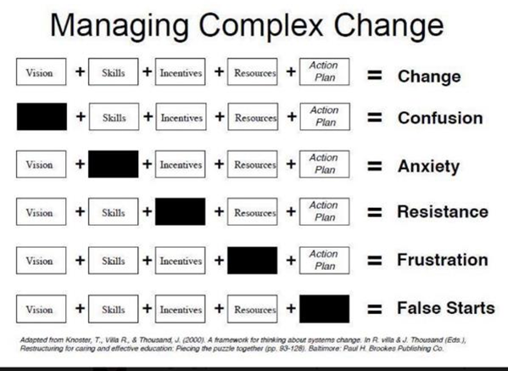
If You Get a Symptom on the Right, You Missed a Box
These Are All Core Components of Your Transformation Plan
Vision
The first meeting with stakeholders is about why you need to change so they really get it
Skills
Skills include strategic planning, change management, modelling, and research
Incentives
Money is often a small part as intrinsic rewards, removing negatives, and increasing the right to win count more
Resources
Be careful here as discretionary energy is largely a myth
Action Plan
Use SMART objectives and reviews

Slide 11
Homework Assignment: Get out of Your Echo Chamber
Extra Credit for Reading Innovate to Dominate from NAW First
A large list of research links follow that should be reviewed by all the members of your leadership team
  Set a date for your team’s readout on their research findings in a virtual meeting
Based on the combination of their company insights and this new information, each team member prepares a short 5 slide PowerPoint deck responding to these topics, as appropriate
  These are the key things that I believe should be in our evolving value proposition
  This is what I see as our sweet spot customer segments and where they will be in five years
  These are the key actions I think we need to take with respect to our own sales transformation
  These are the new things that I learned that were surprising or interesting
  This is the digital capability that, if we created it, would have the largest short term commercial impact
  This is my best guess at what our competitors are doing right now around sales enablement and digital transformation
  I came up with a couple of insights that might have some significant positive impacts for us
  I also feel that we may be behind in some areas that could create a threat to our plans
  Based on this research, I have a few insights that helped me understand what our customers have been doing that might be worth discussing
  Based on some of the innovation ideas that I have seen, I think that these might be our best potential customer or supplier to set up a digital innovation project

Slide 12
Newsletters – Thought Leadership
Engage in the Ongoing Flow of Information and Progress in Transformation
https://go.forrester.com/?utm_source=forrester_newsletter&utm_medium=email&utm_campaign=cso_productivity&utm_content=webinar
https://www.gartner.com/en/sales
https://www.mckinsey.com/business-functions/marketing-and-sales/our-insights
https://www.mdm.com/
https://www.ircg.com/blog
https://distributionstrategy.com/distribution-strategy/
https://blog.prosci.com/
https://blog.feedspot.com/change_management_blogs/
https://markdancer.substack.com/
https://a16z.com/2019/08/16/software-eaten-world-healthcare/
https://hbr.org/2012/07/the-game-buyers-play-with-vend?utm_source=feedburner&utm_medium=feed&utm_campaign=Feed%3A+harvardbusiness+%28HBR.org%29
Don’t forget your trade association, marketing group, and suppliers as everyone is trying to figure out their own path forward

Slide 13
Potential Software or Service Providers
This is not an exhaustive list and focusses on a few best of breed solutions, leaving out the enterprise-wide alternatives
https://conexiom.com/
https://proton.ai/
https://leadmastercrm.com/
https://www.mdm.com/mdm-analytics/
https://epacube.com/
https://www.sparxiq.com/
Random links that may be of interest
https://www.mckinsey.com/business-functions/transformation/our-insights/transformation-in-uncertain-times-tackling-both-the-urgent-and-the-important
https://www.forbes.com/sites/johngreathouse/2013/04/30/5-time-tested-success-tips-from-amazon-founder-jeff-bezos/?sh=16598bf1370c
https://medium.com/thethursdaythought/if-the-rate-of-change-on-the-outside-exceeds-the-rate-of-change-on-the-inside-the-end-is-near-3145f65c9c61
https://en.wikipedia.org/wiki/Two-factor_theory
https://www.managementconsultingconnection.com/frs/16490069/how-to-overcome-the-pain-points-of-your-crm/download
https://www.mdm.com/podcasts/interview-with-netplus-alliances-jennifer-murphy-and-developing-professionals-lori-miller-on-organizational-restructuring/?utm_source=Podcasts&utm_medium=Other+Communications&utm_campaign=1100000092&oly_enc_id=3358C6999023A5M
Our Event Sponsor

Slide 14
Practitioner How-To Books
www.naw.org/ffc19
https://www.naw.org/product/effective-sales-incentive-design-for-distributors-whats-the-right-plan/
https://www.amazon.com/gp/product/B002Q6XUE4?notRedirectToSDP=1&ref_=dbs_mng_calw_0&storeType=ebooks
https://www.amazon.com/gp/product/0749496975/ref=pe_27541010_598852650_em_1p_1_lm
https://amazon.com/Effective-Change-Managers-Handbook-Management/dp/074947307X/ref=sr_1_3?dchild=1&keywords=change+managers+handbook&qid=1628095557&sr=8-3
https://www.amazon.com/s?k=business+model+generation&ref=nb_sb_noss_1
https://www.amazon.com/s?k=hard+thing+about+hard+things&ref=nb_sb_noss_1
https://www.amazon.com/Islands-Profit-Sea-Red-Ink-dp-1591843499/dp/1591843499/ref=mt_other?_encoding=UTF8&me=&qid=1628096419

Slide 15
Thank You

